Slide 1
Characterizing Thoughts and Attitudes of Instructors on Resource Based Materials
An investigation of the thoughts and attitudes of instructors about incorporating resource based materials into their curriculum.
.
By: Katie Marvin

Slide 2
Key Terms
Epistemology
Misconceptions
Pedagogy
Resources

Slide 3
What is PER?
Aids instructors in helping students learn physics by coming up with new teaching methods.
New methods are developed by studying common misconceptions students have.
Addresses the following ideas:
Attitudes
Conceptual understanding
Epistemology
Instructional interventions
Instructional materials
Problem-solving
Social aspects
Technology

Slide 4
Research Question
What are the motivating factors behind the decision of instructors whether or not to incorporate into their curriculum instructional materials that elicit and build on student resources?

Slide 5
Claim
Instructors will be receptive to the materials but hesitate to incorporate them due to concerns about their practicality.
In this context, practicality includes the following: time, level of engagement, appropriateness of content for the course objectives, or budgeting.

Slide 6
Preliminary Work Done by Research Team
Developed introductory, concept-specific instructional materials with a resource-oriented framework.
These materials were shown to instructors before being interviewed
Interviewed 9 physics instructors to investigate:
Attitudes towards incorporating resource-oriented materials into their curriculums
What they are currently doing in their classes.
Interview sessions were semi-structured and lasted between 30 – 60 minutes.
Their responses were recorded and transcribed via TEMI

Slide 7
Current Work
Corrected transcription errors
Developed a method of turning interviews into analytic memos
Created a synthesis of instructor responses
Analyzed the synthesis to generate the results
Wrote a research paper on results

Slide 8
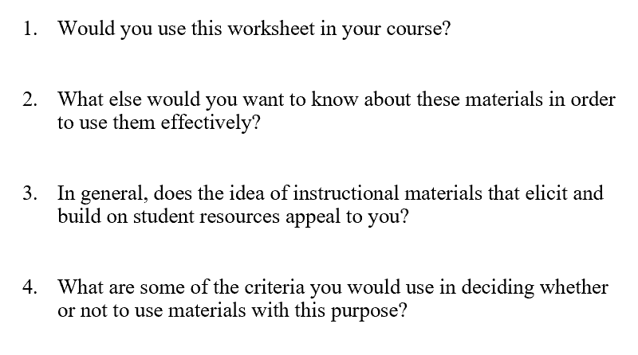
Most Relevant Interview Questions
Adapted from research questions provided by Amy Robertson, Lauren Bauman, and Clausell Mathis. (source 4)

Slide 9
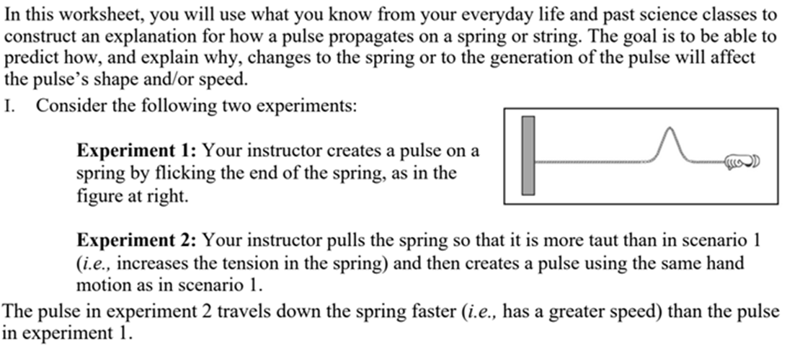
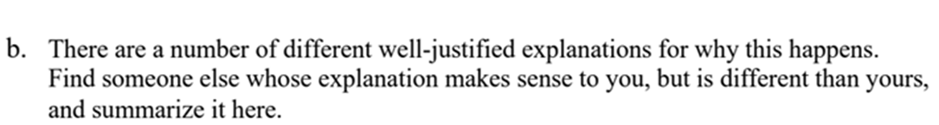
Sample of Worksheet
Participants were given access to the entire worksheet [4] before the interview. This is picture is part of question 1 of the worksheet.

Slide 10
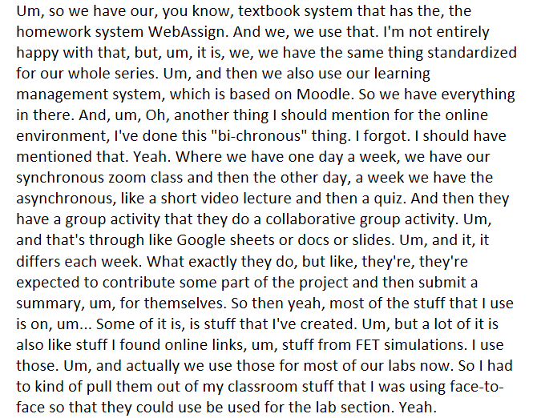
Analytic Memo
Raw answer from an instructor. [4]

Slide 11
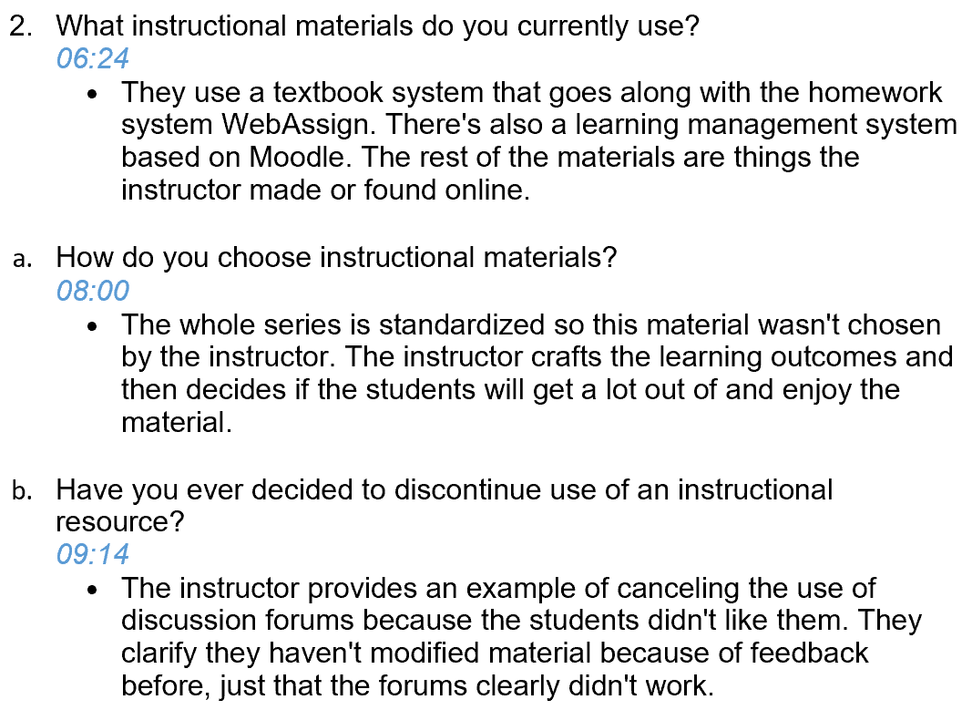
Analytic Memo
Cleaned up and boiled down to the important information.

Slide 12
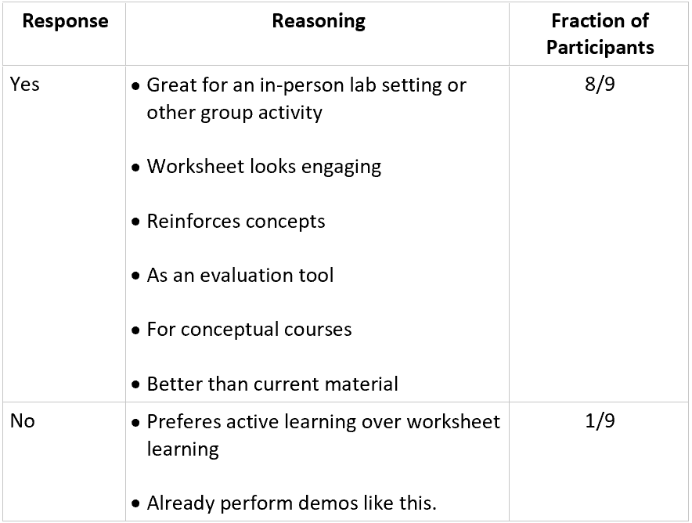
Results
Would you use this worksheet in your course?

Slide 13
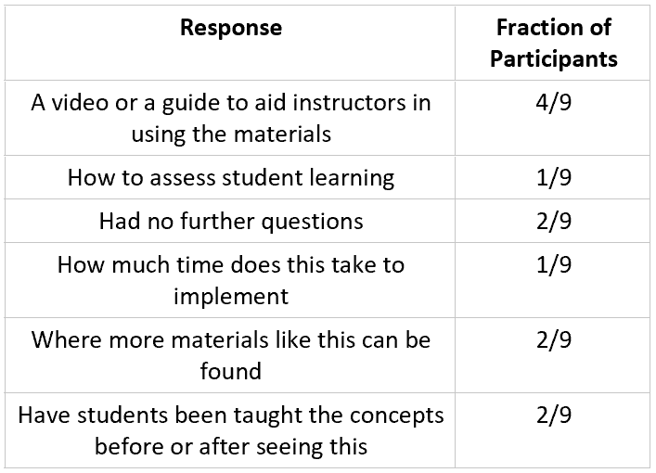
Results
What else would you want to know about these materials in order to use them effectively?

Slide 14
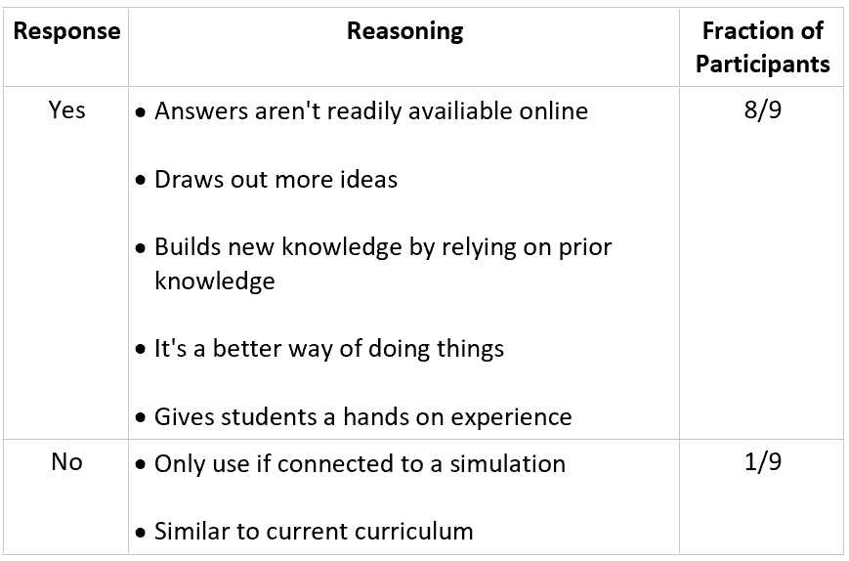
Results
In general, does the idea of instructional materials that elicit and build on student resources appeal to you?

Slide 15
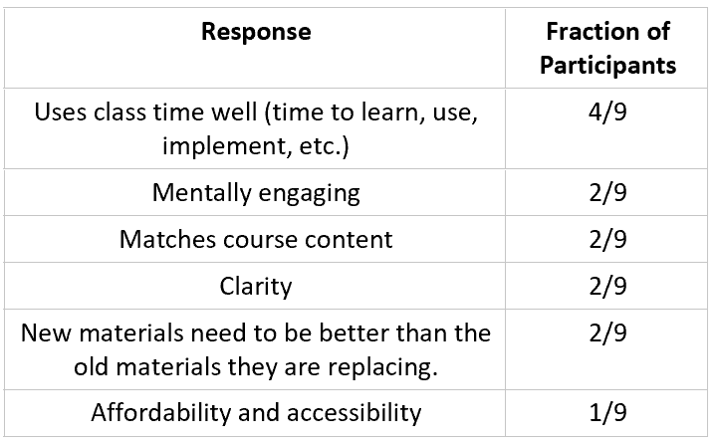
Results
What are some of the criteria you would use in deciding whether or not to use materials with this purpose?

Slide 16
Conclusion
Instructors were receptive to using the resource-based materials, but had concerns about practicality.
Concerns about practicality include:
time
appropriateness of content for the course objectives
level of engagement
budgeting.
The synthesis will also prove helpful for future work as it will act as a detailed reference sheet for this data, allowing for quicker analysis

Slide 17
Sources
Beichner, R. (2009). An Introduction to Physics Education Research. In Getting Started in PER (2).
Retrieved April 10, 2021, from https://www.compadre.org/Repository/document/ServeFile.cfm?ID=8806&DocID=1147
Hammer, D., Elby, A., Scherr, R. E., & Redish, E. F. (n.d.). Resources, framing, and transfer [PDF].
Greenwich, CT: Information Age Publishing. Retrieved April 10, 2021 from http://www2.physics.umd.edu/~elby/papers/Hammer_Elby_et_al_transfer.pdf
Henderson, C., & Harper, K. (Eds.). (2009). Getting Started in PER (Vol. 2)
Retrieved April 10, 2021, from https://www.compadre.org/per/per_reviews/volume2.cfm
4. Interview questions, worksheet, and data provided by Amy Robertson, Lauren Bauman, Lisa Goodhew, and Clausell Mathis

